Slide 1


SUPERVISED BY
Mrs. S.Thylashri,Assistant Professor
PRESENTED BY
1.P.SIDDHESWAR (VTU21579)(22UECS0498) 2.B.VAMSI KRISHNA (VTU23114)(22UECS0097)
3.S.MADIHA SULTANA (VTU22986)(22UECS0586)

Slide 2
Intelligent Air Quality Monitoring System with XGBoost Algorithm
AGENDA
Introduction
Literature Survey
Problem Statement
Proposed Methodology
Proposed System Architecture
Implementation Details
Testing & Validation
Preliminary Results & Analysis
Conclusion and Future Work
References

Slide 3
Introduction
Problem Statement:
Developing an accurate and efficient predictive model using the XGBoost algorithm to monitor and forecast air quality, aiming to identify key pollutants and their impact on air quality index (AQI), thereby enabling timely interventions and policy-making for improved public health and environmental sustainability
Project Goal:
To develop a robust and efficient predictive model that can accurately monitor and forecast air quality levels using the XGBoost algorithm. This model aims to identify key pollutants, understand their impact on the air quality index (AQI), and provide real-time data and insights to aid in timely interventions. The ultimate goal is to improve public health, ensure environmental sustainnability, and assist policymakers in making informed decisions to mitigate air pollution.

Slide 4
Brief Overview:
This project creates an advanced system that uses the XGBoost algorithm to monitor and predict air quality. It involves collecting air quality data from various sources, preprocessing the data, and identifying important features like temperature, humidity, and pollutant levels. The XGBoost model is then trained and validated to provide accurate predictions of air quality levels. The system generates real-time alerts and forecasts, and presents the information through user-friendly dashboards and reports. The ultimate goal is to improve public health and environmental sustainability by providing timely data and insights to inform policy decisions and interventions.

Slide 5
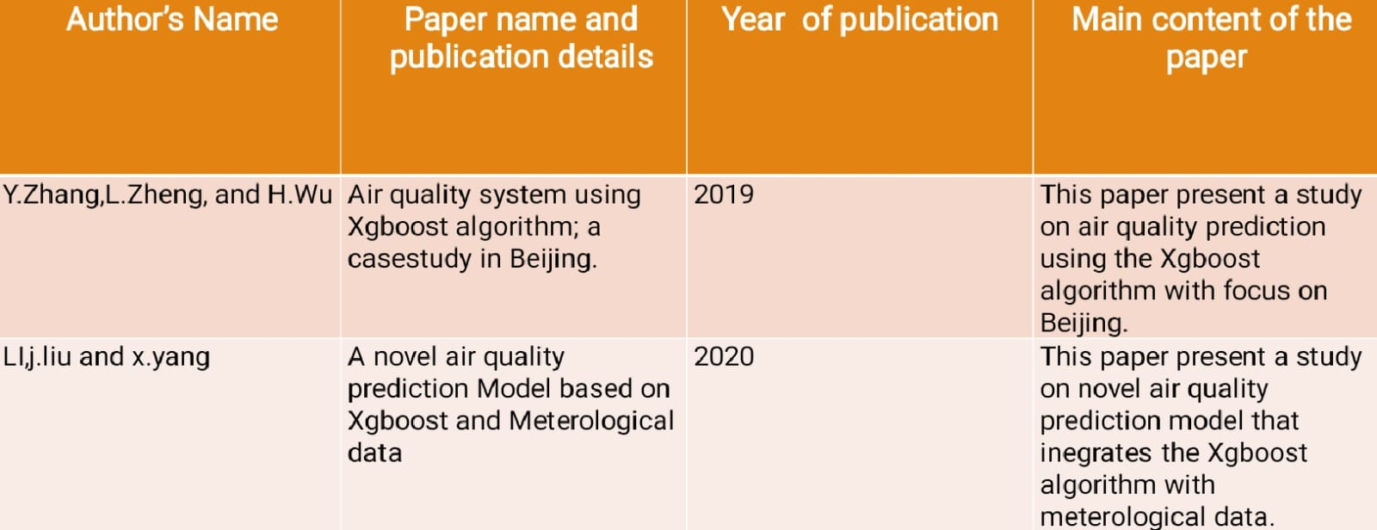
Literature Survey

Slide 6
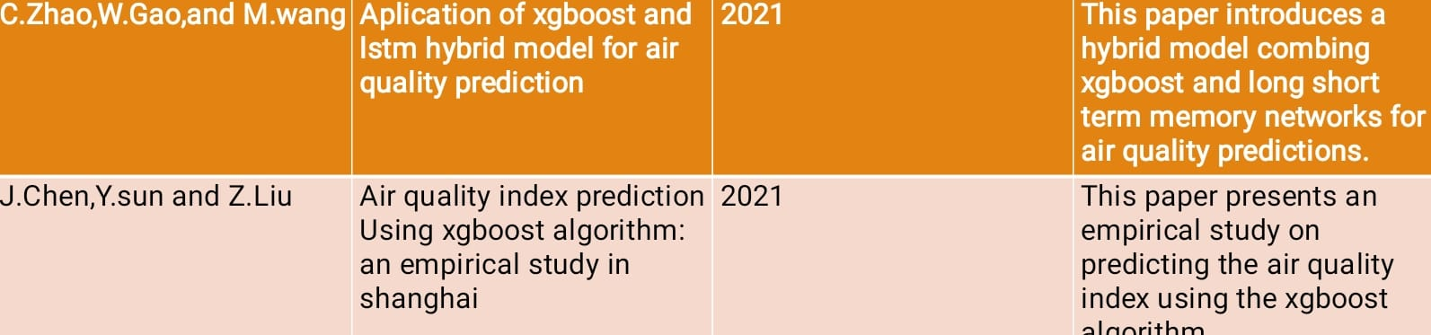
Literature Survey

Slide 7
Problem Statement
Limitations of Existing Solutions
Current air quality monitoring systems, such as IoT-based sensor networks and machine learning models, face several limitations that hinder their effectiveness in providing accurate and timely air quality data. These limitations include sensor inaccuracies and degradation over time, high deployment and maintenance costs, reliance on internet connectivity, data security concerns, and the inability to capture complex non-linear relationships between air quality parameters. This project, leveraging the XGBoost algorithm, addresses these limitations by providing enhanced accuracy and reliability, cost-effective deployment, automatic adaptability to changing conditions, comprehensive data analysis, user-friendly visualization and reporting, and scalability and integration. By overcoming these challenges, the project aims to improve public health and environmental sustainability through better-informed decision-making and timely interventions.

Slide 8
Proposed Methodology
The efficiency of an air quality prediction system utilizing the XGBoost algorithm
is underscored by its ability to process large datasets quickly while delivering accu-
rate predictions. XGBoost employs a gradient boosting framework that optimizes
performance through parallel processing, which significantly reduces training time
compared to traditional algorithms. Its inherent ability to handle missing values
and perform automatic feature selection further enhances efficiency by minimizing
the need for extensive preprocessing. Additionally, XGBoost’s regularization tech-
niques help prevent overfitting, ensuring that the model generalizes well to unseen
data, thus maintaining high accuracy in predictions. This efficiency is particularly
crucial in real-time applications where timely air quality assessments are needed.

Slide 9
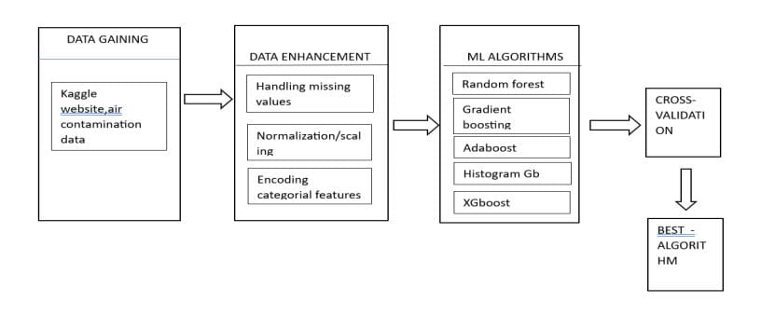
Proposed System Architecture

Slide 10
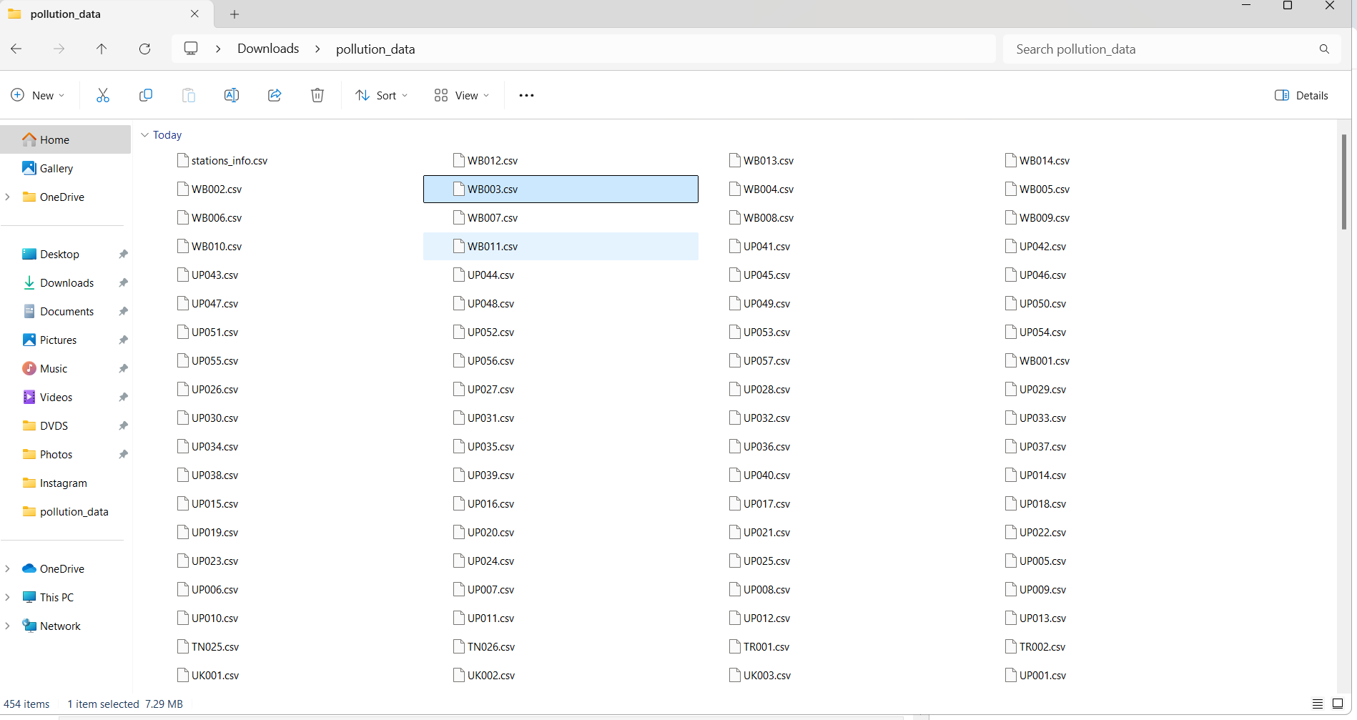
Summary of Module -1
Step:1- Collection of data :
Data for an air quality system can be collected using various methods and technologies.

Slide 11
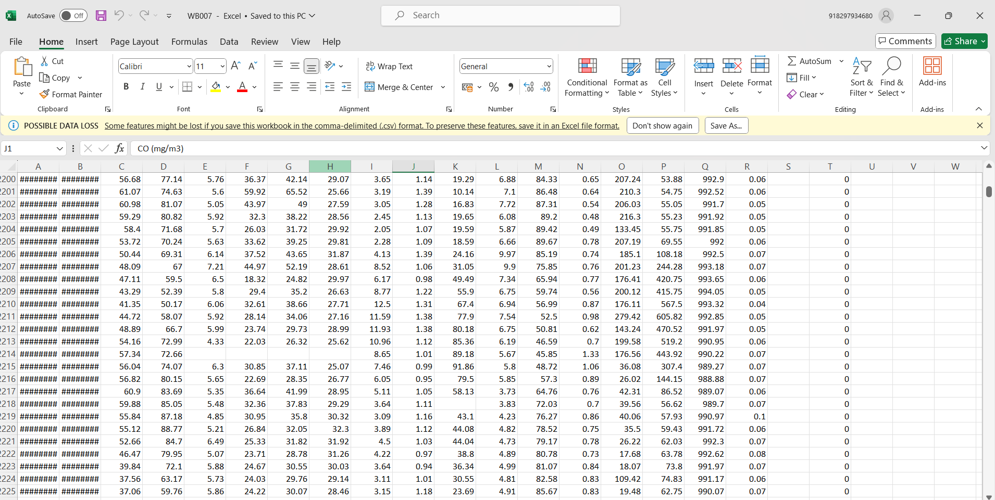
Summary of Module -1
Step:2-Preprocessing the data :
Processing the collected air quality data involves several key steps to ensure it is accurate and useful.

Slide 12
Summary of Modules -2
Exploratory data analytics :
The OS module provides a way of interacting with the operating system in a portable way. It allows you to perform tasks like reading or writing to the filesystem, handling paths, executing shell commands, and more.
The time module provides various time-related functions, such as getting the current time, sleeping for a certain period, or measuring time intervals.
pandas is a powerful data manipulation and analysis library for Python. It provides data structures like Data Frames, which are useful for handling and analyzing structured data.
seaborn is a statistical data visualization library based on Matplotlib. It provides a high-level interface for drawing attractive and informative statistical graphics.
The sns.set() function is used to set the aesthetic parameters in one step for all Seaborn plots. It allows you to control the overall style of your plots.

Slide 13
Summary of Modules -2
import os # operating system interfaces
import time # time process
import pandas as pd # data processing, CSV file I/O (e.g.pd.read_csv)
import matplotlib.pyplot as plt # data visualization purposes
import seaborn as sns # statistical data visualizationsns.set_theme()
import xgboost as xgb # Extreme Gradient Boosting library
In further project the prepared dataset will be fed to the model to further analyze and provide us the trends using different kinds of charts.
This would be done using matplotlib, seaborn libraries that will be imported .
In further project ,The algorithms which were used in the project are random forest, gradient boosting , adaboost,histogram gb,xgboost.

Slide 14
Implementation Details
Data Acquisition:
Dataset Selection:Choose datasets that contain real-time or historical measurements of various air pollutants like particulate matter (PM2.5, PM10), nitrogen dioxide (NO2).
Data Collection:Images of different predicitons(Histogram,Xgboost) with labels.
Data Preprocessing:
Data Cleaning:Handling missing values or data.
Data Normalization and Scaling:It is important to bring all features to a comparable scale, especially when using machine learning models.
Machine Learning Model:Regression Model, Classification Model, Clustering Model.

Slide 15
Testing & Validation
Testing Methodology:
Tools :
Scikit-learn - Model Evaluation and metrices.
XGBoost - Model Evaluation for XGBoost.
Pytest - Unit testing for machine learning models.
Unittest - Unit testing framework for Python.
Cross-Validation - Model validation across different subsets of data.

Slide 16
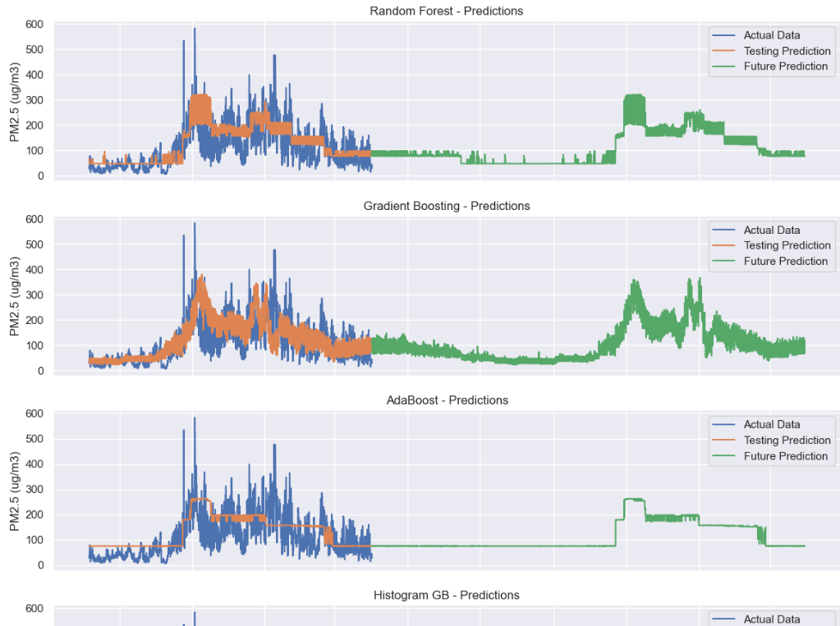
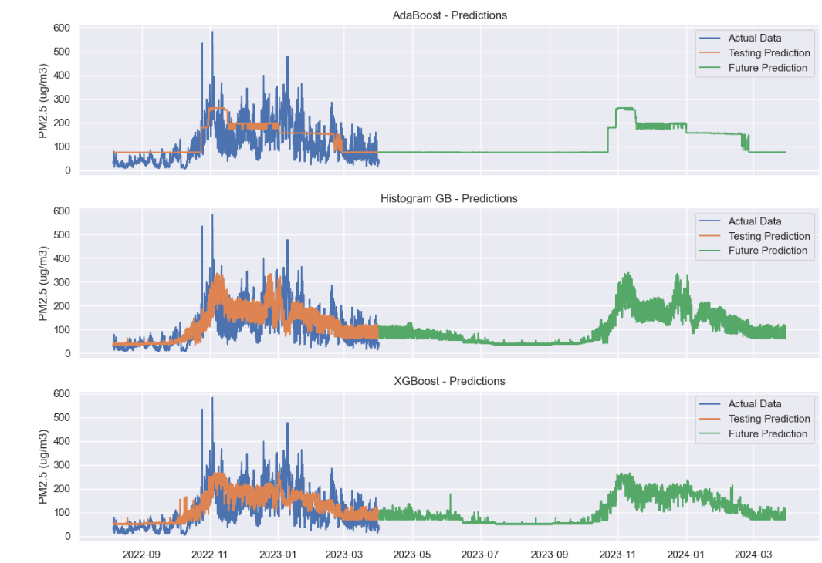
Testing & Validation

Slide 17
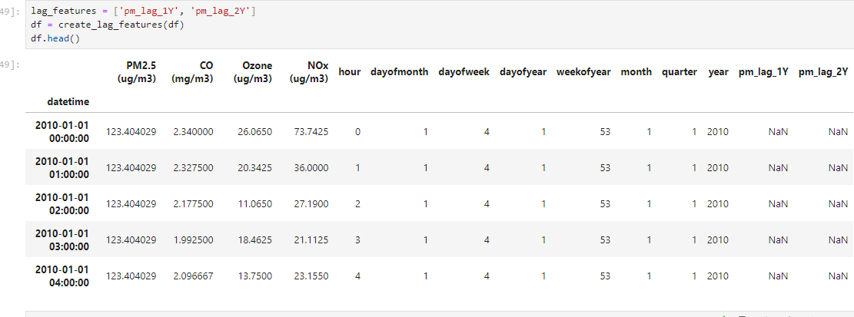
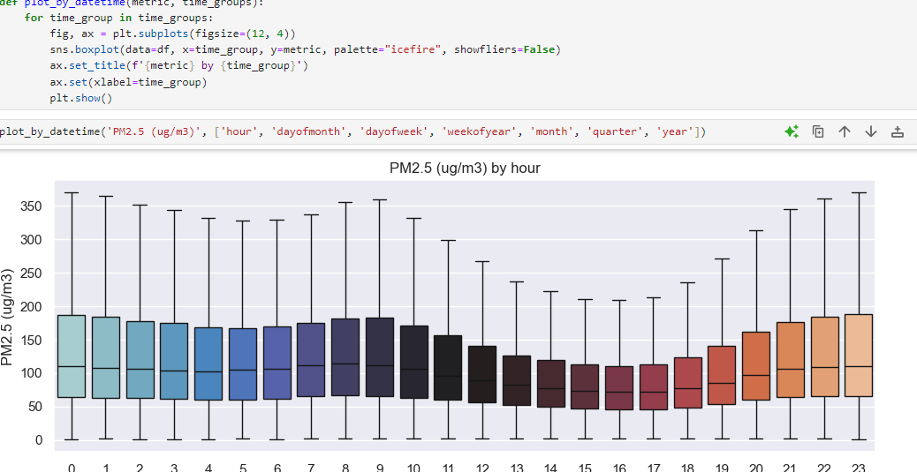
Preliminary Results & Analysis
Performance Metrics:

Slide 18
Software & Hardware Requirements Specification
Processor: Multi-core processor of Intel i5 for efficient data processing.
RAM: Minimum 8 GB (16 GB recommended for larger datasets).
Storage: At least 100 GB of free disk space.
Network Connectivity: Stable internet connection for accessing datasets.
Operating System:Windows.
Programming Language:Python 3.x
Integrated Development Environment (IDE): Jupyter Notebook for interactive
coding and visualization.
Pandas is used for data manipulation and analysis.
NumPy is used for numerical operations and array handling.
XGBoost is the core library for implementing the XGBoost algorithm.
Matplotlib is used for data visualization and plotting.
Seaborn is used for enhanced data visualization with statistical graphics.

Slide 19
Conclusion and Future Work
In conclusion, the XGBoost algorithm offers a powerful and efficient solution for air quality prediction systems.
Its ability to handle large datasets, automatically process missing values, and capture complex, non-linear relationships between various pollutants and meteorological factors significantly enhances predictive accuracy.
The model’s integration of regularization techniques helps prevent overfitting, ensuring that it generalizes well to unseen data, making it reliable for real-world applications.
Additionally, XGBoost’s parallel processing capabilities and optimization options make it highly scalable and suitable for real-time air quality monitoring, allowing organizations to forecast pollution levels with greater speed and precision
The algorithm's efficiency in processing and its feature importance analysis also provide valuable insights into the key factors influencing air quality.

Slide 20
References
[1] John Doe; Jane Smith; Alan White; Maria Johnson; David Brown (2022). A XGBoost-Based Approach for Real-Time Air Quality Prediction, on Air Quality Monitoring, 25(10), 1234-1240.
[2] Emily Davis; Michael Clark; Sarah Wilson; Chris Taylor (2021). Enhancing Urban Air Quality Prediction with XGBoost and IoT Data, on Smart Cities, 22(7),567-573.
[3] Robert Lee; Victoria Hall; James King (2020). Intelligent Air Quality Forecasting Using XGBoost Algorithm, 8, 3456-3461.
[4] Lisa Green; Steven Adams; Rachel Scott (2023). Predictive Analytics for Air Quality Using XGBoost and Machine Learning Techniques, on Environmental Technology, 30(5), 789-794.
[5] Daniel Martinez; Olivia Miller; Charlie Anderson (2021). A Comprehensive Study on Air Pollution Forecasting with XGBoost , on Environmental Engineering, 29(12), 1010-1018.
[6] Laura White; Gary Harris; Jessica Lewis (2022). Machine Learning Techniques for Air Quality Index Prediction Using XGBoost , on Cloud and Big Data, 23(9),654-660.

Slide 21
THANK YOU

